Slide 1
A FEW EXAMPLES

Slide 2
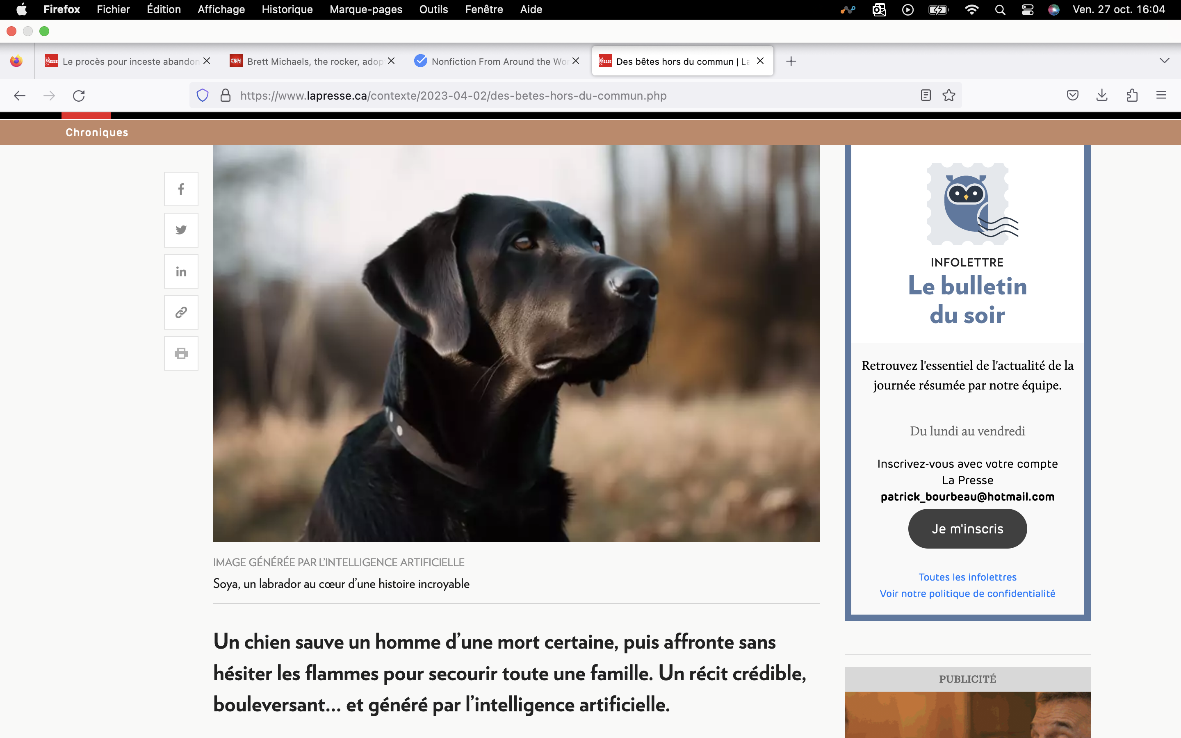
A STORY AND PICTURES ENTIRELY GENERATED BY AI

Slide 3
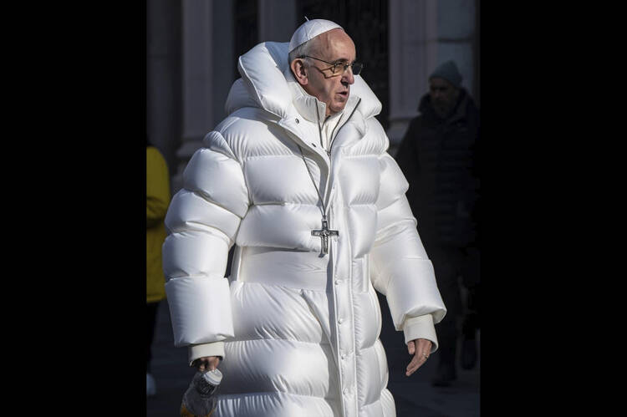
THE BALENCIAGA WEARING POPE
<number>
Notes:
<number>

Slide 4
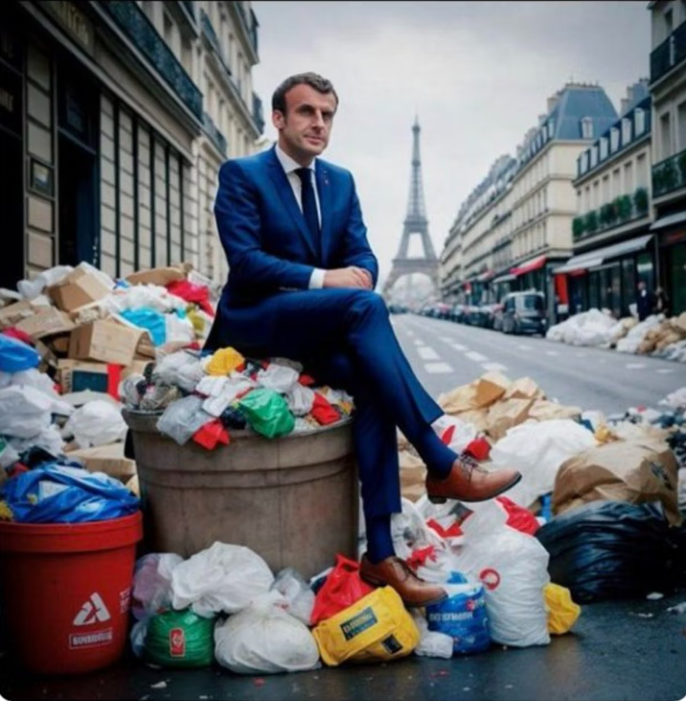
EMMANUEL MACRON AMID THE PARIS THRASH
<number>

Slide 5
RESEARCH TIME TO FIND THIS PICTURE: 45 minutes
POTENTIALLY A HUGE TIME SAVER
AI crEation TIME FOR THESE PICTURES : 5 minutes
L’Intelligence artificielle et la publicité dans La Presse

